Slide 1


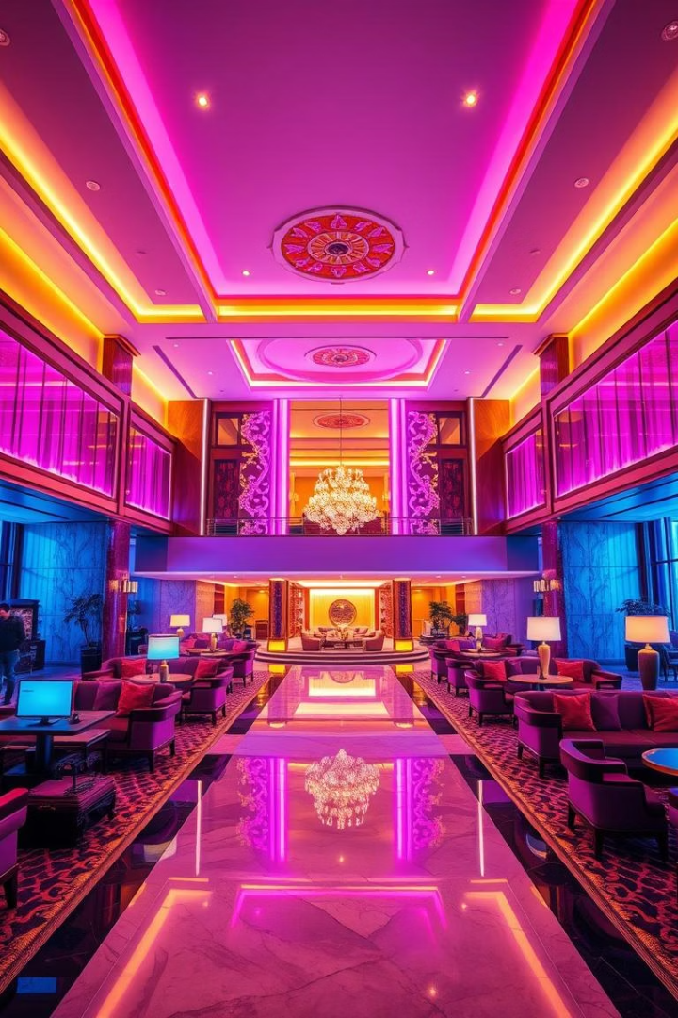
Problem Statement
AtliQ Grands, a prestigious chain of five-star hotels across India, is facing a decline in market share and revenue in the luxury/business hotel category. The downturn is due to increasing competition and poor strategic decision-making. In response, the management has decided to adopt Business and Data Intelligence practices to uncover actionable insights from historical data.
Guided By: Dhaval Patel, Hemanand Vadivel

Slide 2
Project Overview
Client:
Deliverables:
AtliQ Grands (Hospitality Sector)
A complete metrics dashboard
Duration:
Insights not covered in the predefined metric list
Data-driven recommendations
May, June, July 2022
Project Objectives
Goal:
Design metrics aligned with business KPIs and stakeholder needs.
Analyze operational and revenue data to identify issues and opportunities.
Create an interactive dashboard reflecting historical performance and trends.
Identify hidden insights beyond the standard metrics.
Enable management to make informed strategic decisions for market recovery.
Pinpoint underperforming properties, channels, and times of the month to optimize operations and marketing strategies.

Slide 3






Key Insights
Revenue Decline in July 2022:
Mid-Month Booking Trends:
Customer Ratings:
Hotel-Level Insights:
Revenue dropped by -11.61%.
2nd and 3rd weeks show consistent drops in bookings across months.
Average rating is 3.61—stable but suggests room for improvement.
AtliQ Palace and AtliQ Exotica are top-performing hotels.
Major contributors: 12.14% decline in Total Bookings, 14.15% drop in Occupancy %, and 11.13% rise in unused capacity.
Likely seasonal/industry pattern—requires benchmarking against competitors.
Ratings are critical to brand perception and customer trust.
AtliQ Seasons, a business-class hotel, has alarmingly low rating (2.30) in July 2022.
Cancellation rate remained steady (24–25%) and is not a primary reason for the revenue drop.
Suggestion: Launch mid-month promotional offers to boost engagement.
Business-class segment underperforms in both revenue and satisfaction.
City-Level Observations:
Channel Distribution:
Mumbai: Highest revenue contributor.
MakeMyTrip contributes ~20% of revenue.
Bangalore: Lowest occupancy but 2nd in revenue—high-value bookings with low cancellations.
~40% of bookings are from unknown sources—requires identification for better targeting.
Delhi: Underperforming across all metrics.
Elite segment: High revenue, 2nd highest occupancy but a rising cancellation trend.

Slide 4
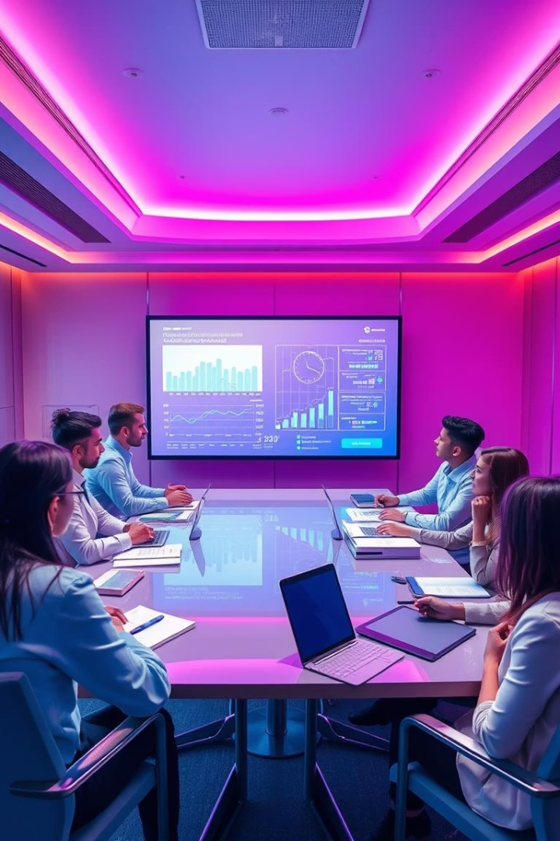
Conclusion
This analysis empowers AtliQ Grands to make evidence-backed decisions for improving bookings, enhancing customer satisfaction, and strengthening underperforming areas. The focus on granular insights like mid-month drops, property-specific issues, and channel breakdowns offers a path to recover lost revenue and market position.

